Slide 1
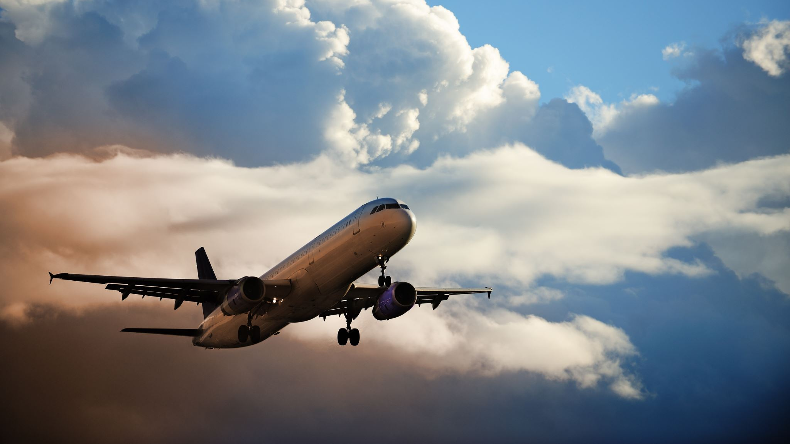
Newark Airport Flight Delays
Chris Allen

Slide 2
Overview
In 2017, Newark Airport (EWR) had the worst on-time performance of all airports in the USA*
Airports can be fined/forced to pay compensation for flights which are delayed by more than 15 minutes
It is believed that poor weather conditions are causing departure delays
The purpose of this analysis is to:
Understand how serious significant weather-related delays are
Investigate other factors impacting delays: seasonal/temporal effects?
Compare performance to other New York airports, namely JFK and La Guardia (LGA)

Slide 3
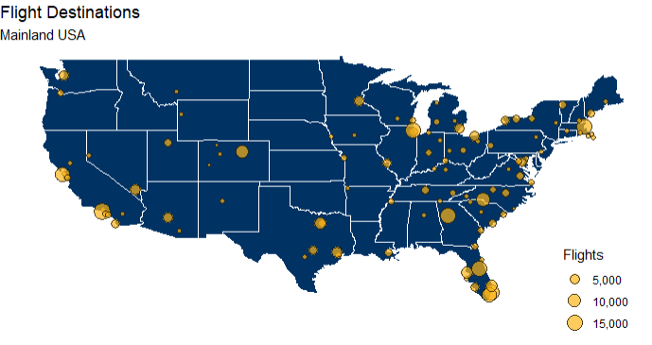
Process
Data:
Domestic flight data (30k observations over 3 NYC airports)
Weather (time-series)
Airport (geospatial)
Airline and Plane data
All data is open source and not personally identifiable
Cleaning/Wrangling:
Dealing with missing values
Joining datasets
Explanatory Data Analysis
Understand past observations
Predictive Model
Train and test model for predicting likelihood of a delay

Slide 4
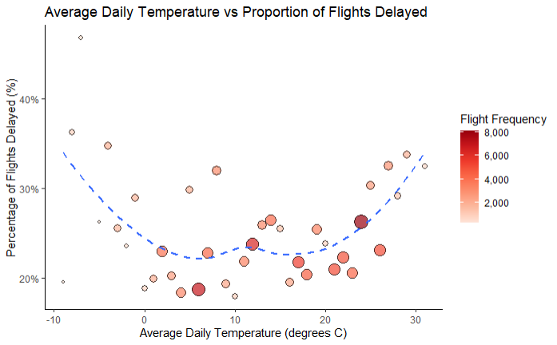
Weather Impacts - Temperature
Winter months, poorer weather conditions
Significant increases in the proportion of delayed flights at low (<0ºC) and high daily temperatures
However, the likely reasons behind the cause of the delays are different
Low temperatures represent winter months where weather is poorer
High temperatures represent peak travel season, stress on airports due to high number of passengers
Peak holiday season (summer)

Slide 5
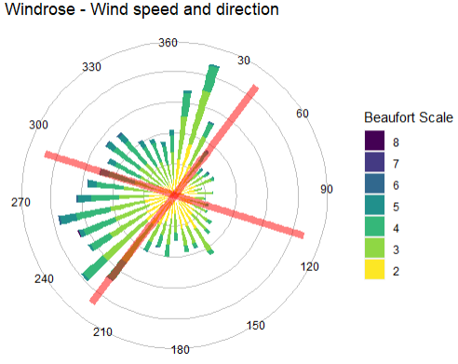
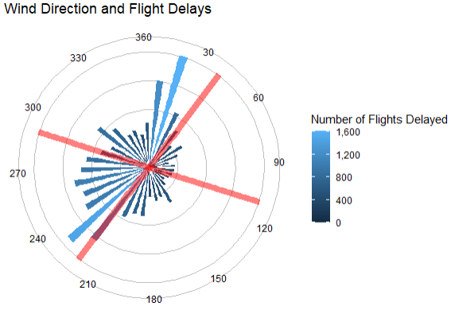
Weather Impacts - Wind
Red lines represent runway orientation at Newark Airport
Orientation of runways appears to match wind direction
Large number of flight delays when wind is 230 and 20 degrees.
No data on which runway was used for each flight

Slide 6
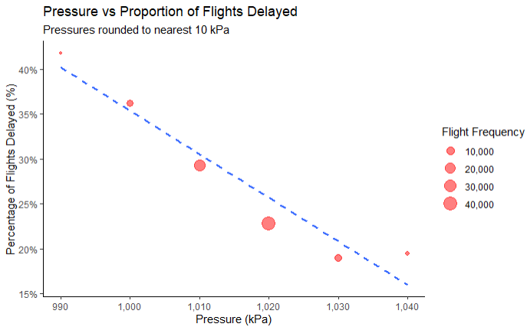
Weather Impacts – Pressure
Negative correlation between pressure and proportion of delayed flights
High-pressure areas are associated with lighter winds and clear skies = good conditions for flying
Low-pressure areas are commonly associated with inclement weather (such as cloudy, windy, with possible rain or storms) = poor conditions for flying

Slide 7
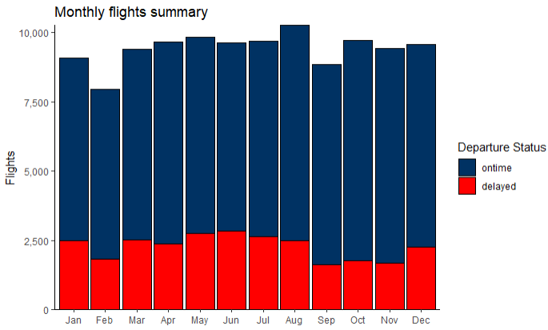
Other Effects – Seasonal
Number of monthly scheduled flights is between 7,900 (in February) and 10,200 (in August)
Monthly flights increase during summer with an increase in flights delays too
June has the highest number of delayed flights across the entire year.
Lowest flight delays observed between September and November, i.e. calmer weather
Increase in flights delays during December and January – this could be attributed to poor weather conditions
Lowest Delay Rate: 17.7%
Highest Delay Rate: 29.4%

Slide 8
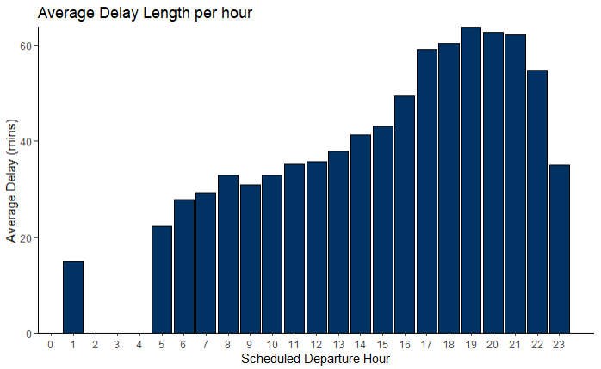
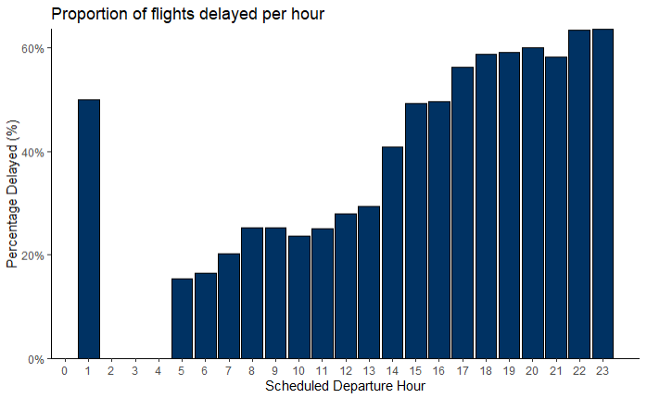
Other Effects – Temporal
Proportion of delayed flights increases as the day progresses
The length of delays also increases throughout the day
This suggests that there may be some form of “domino” effect from earlier flights

Slide 9
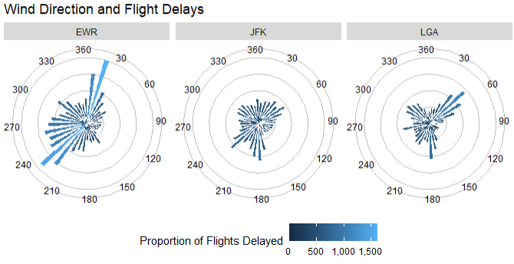
Comparison with other NYC Airports
Parameter | Newark | JFK | La Guardia
Total Domestic Flights | 113,067 | 92,481 | 90,390
Delayed Flight Rate (%) | 24.1 | 22.1 | 21.1
Avg Departure Delay (mins) | 74 | 77.5 | 80.7
Median Departure Delay (mins) | 51 | 50 | 52
Newark had the highest number of domestic flights but also had the highest proportion of flight delays
However, La Guardia has more extreme delays, and all airports have a similar median departure delay.
JFK and La Guardia have the same runway orientations and the pattern of delays are much less pronounced than Newark’s

Slide 10
Predictive Model
A predictive model was developed to predict if a flight was likely to be delayed
Random Forest classifier yielded the best results,
~84% accuracy on training set
~80% accuracy on test set
Variables of highest importance were:
Time of day (temporal)
Temperature (weather)
Plane Age
Humidity (weather)
Pressure (weather)

Slide 11
Conclusions
The “domino” effect of delays is the biggest influence on further delays
Consider limiting this effect by reviewing the need for additional planes/crew when earlier flights have been delayed
There appear to be issues with the airports capacity to manage flight delays during busy months
Consider staffing levels within airport for improved efficiency for passengers
Consider increasing crew levels to ensure planes are ready to depart as early as possible
Weather has a significant yet complex impact on delays
Need to view the weather holistically rather than focus on individual parameters, i.e. temperature, pressure, wind etc.
Improving planes ability to fly in poorer weather conditions may be beneficial, however, will not address delays from planes arriving at the airport
Use the predictive model to anticipate and plan delays and mitigate where possible

Slide 12

Questions?

